Slide 1
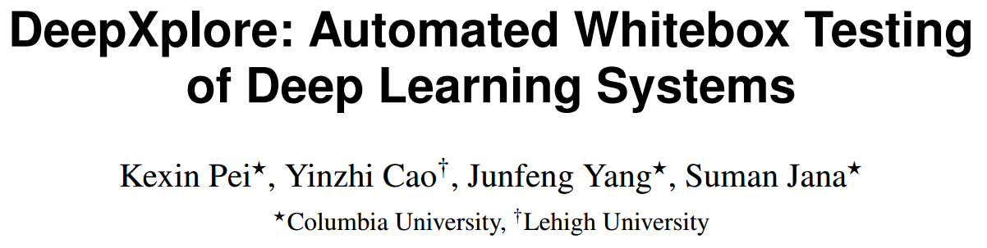


Slide 2
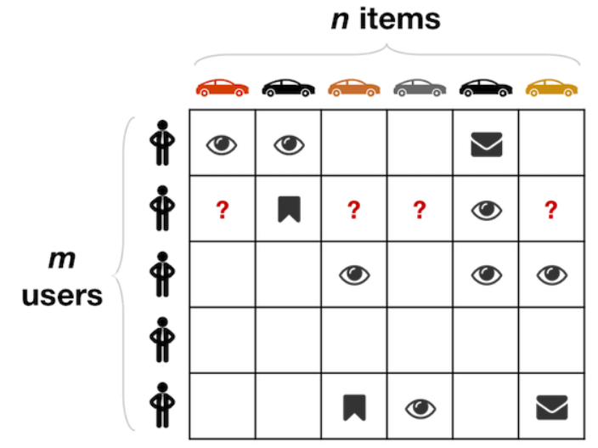

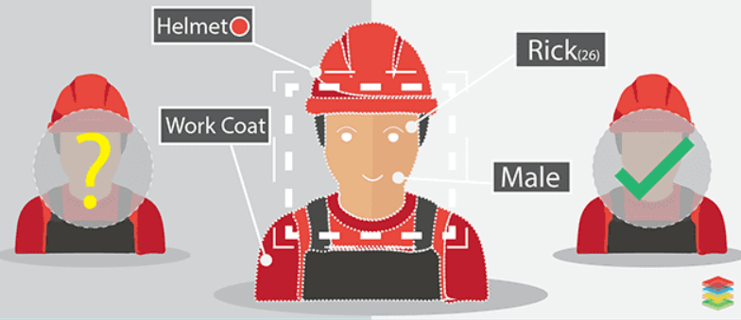

Deep learning is widely used

Slide 3
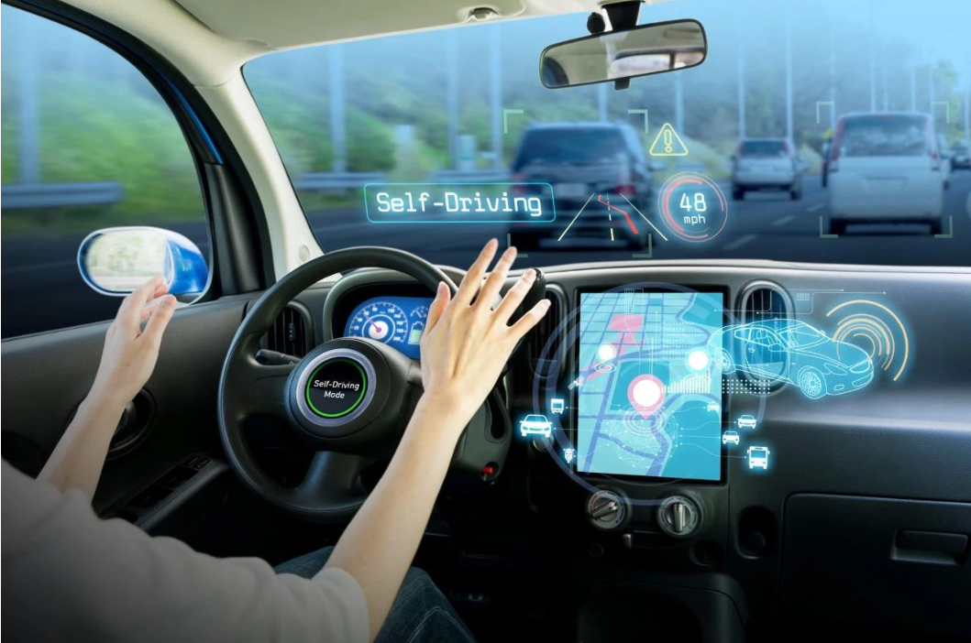
Safety problem of deep learning

Slide 4
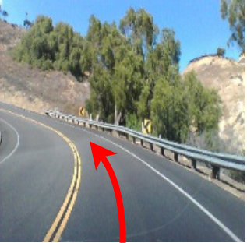
Safety problem of deep learning

Slide 5
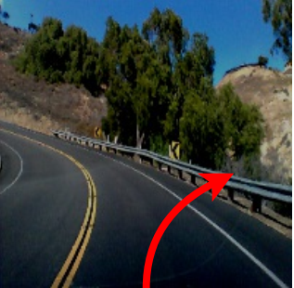
Safety problem of deep learning

Slide 6
Overview
Goal
Find incorrect corner case behaviors of deep learning systems

Slide 7
Overview
Goal
Find incorrect corner case behaviors of deep learning systems
Problems
How good is the quality of the test set
How to generate effective test cases

Slide 8
Overview
Goal
Find incorrect corner case behaviors of deep learning systems
Problems
How good is the quality of the test set
How to generate effective test cases
Contributions
Neuron coverage
Differential testing

Slide 9
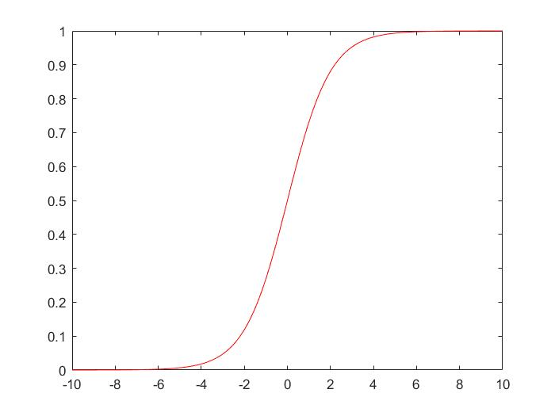
Deep Neural Network ( DNN )
x0
w0
f
x1
w1
output
w2
x2
1
0

Slide 10
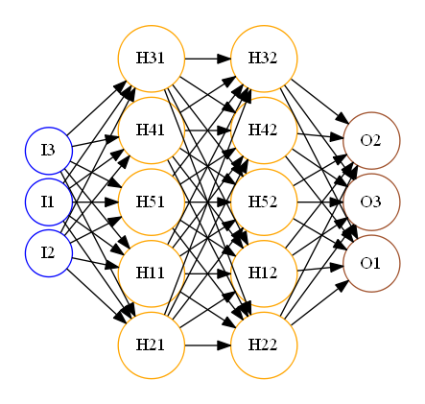
Deep Neural Network ( DNN )

Slide 11
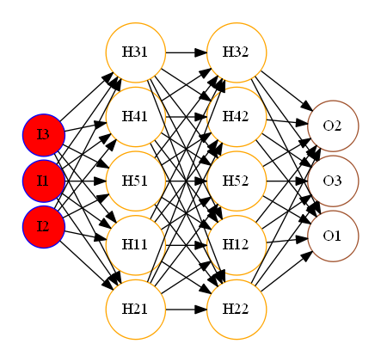
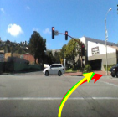
Deep Neural Network ( DNN )

Slide 12
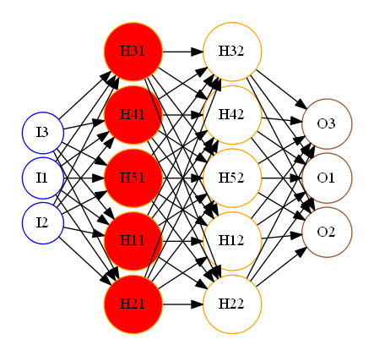
Deep Neural Network ( DNN )

Slide 13
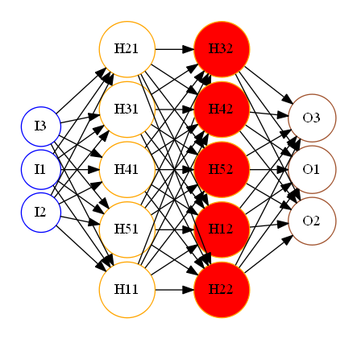
Deep Neural Network ( DNN )

Slide 14
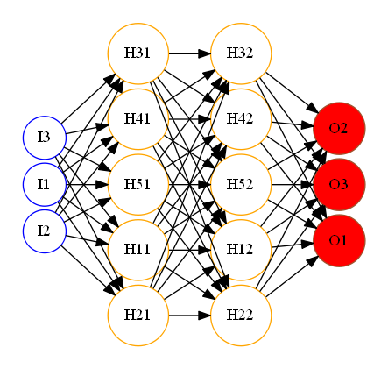
Deep Neural Network ( DNN )
Straight: 0.1
Left: 0.3
Right
Right: 0.6

Slide 15
How good is the quality of the test set

Slide 16
How good is the quality of the test set
Previous solution
Code coverage

Slide 17
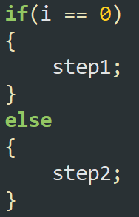
How good is the quality of the test set
Previous solution
Code coverage

Slide 18
How good is the quality of the test set
Previous solution
Code coverage
i = 0

Slide 19
How good is the quality of the test set
Previous solution
Code coverage
i = 0
i = 3

Slide 20
How good is the quality of the test set
Previous solution
Code coverage
Problem
The logic of DNN is in neurons instead of code
Each neuron independently extracts a specifc feature of the input
i = 0
i = 3

Slide 21
How good is the quality of the test set
DeepXplore solution
Neuron coverage
f
output

Slide 22
How good is the quality of the test set
DeepXplore solution
Neuron coverage
activated
f
output

Slide 23
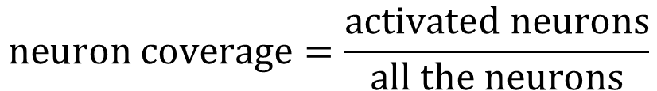
How good is the quality of the test set
DeepXplore solution
Neuron coverage
activated
f
output
$$neuron coverage=\frac{activated neurons}{all the neurons}$$

Slide 24
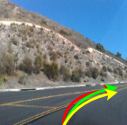
How to generate effective test cases
Previous solution

Slide 25
How to generate effective test cases
Previous solution
Right

Slide 26
How to generate effective test cases
Previous solution
Right
Straight: 0.1
Left: 0.3
Right
√
Right: 0.6

Slide 27
How to generate effective test cases
Previous solution
Right
Straight: 0.1
Left: 0.8
Left
Χ
Right: 0.1

Slide 28
How to generate effective test cases
Previous solution
Heavy burden of manual labeling
Right
Straight: 0.1
Left: 0.8
Left
Χ
Right: 0.1

Slide 29
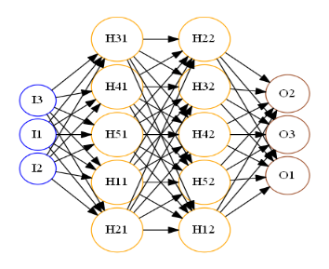
How to generate effective test cases
Differential testing
…

Slide 30
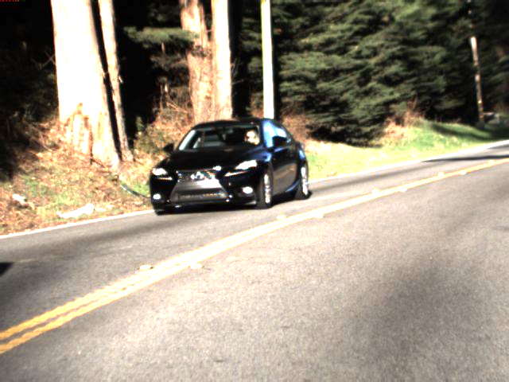
How to generate effective test cases
Differential testing
Seed input : without label
…

Slide 31
How to generate effective test cases
Differential testing
output
Seed input : without label
…
output
output

Slide 32
How to generate effective test cases
Differential testing
output
Seed input : without label
…
Maximize
difference of these outputs
&
neuron coverage
output
output

Slide 33
How to generate effective test cases
Differential testing
output
Seed input : without label
…
Maximize
difference of these outputs
&
neuron coverage
output
output

Slide 34
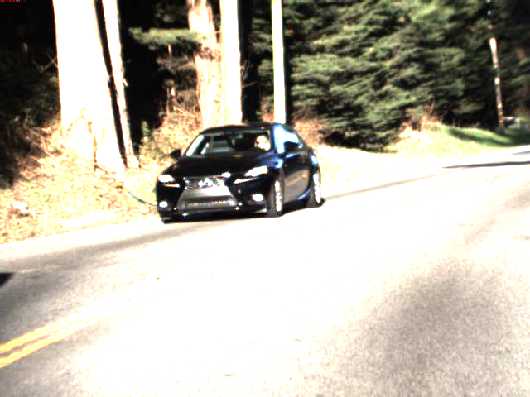
How to generate effective test cases
Differential testing
output
Seed input : without label
…
Maximize
difference of these outputs
&
neuron coverage
output
output

Slide 35
Evaluation
Environment
5 data sets : MNIST, Imagenet, …
15 different DNNs
2000 randomly selected inputs
Problems
Is neuron coverage a good metric
Can DeepXplore find numerous erroneous behaviors
Can DeepXplore improve the accuracy of DNN

Slide 36
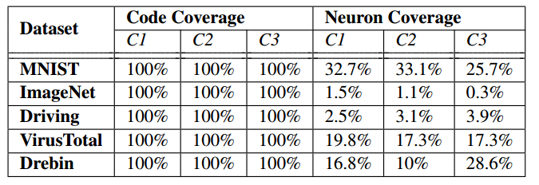
Evaluation
Is neuron coverage a good metric
Comparison of code coverage and neuron coverage for 10 randomly selected inputs

Slide 37
Evaluation
Is neuron coverage a good metric
Comparison of code coverage and neuron coverage for 10 randomly selected inputs

Slide 38
Evaluation
Is neuron coverage a good metric
Comparison of code coverage and neuron coverage for 10 randomly selected inputs

Slide 39
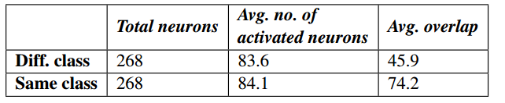
Evaluation
Is neuron coverage a good metric
Average number of overlaps among activated neurons for a
pair of inputs of the same class and different classes.

Slide 40
Evaluation
Is neuron coverage a good metric
Average number of overlaps among activated neurons for a
pair of inputs of the same class and different classes.

Slide 41
Evaluation
Is neuron coverage a good metric
Average number of overlaps among activated neurons for a
pair of inputs of the same class and different classes.

Slide 42
Evaluation
Is neuron coverage a good metric
Average number of overlaps among activated neurons for a
pair of inputs of the same class and different classes.

Slide 43
Evaluation
Is neuron coverage a good metric
Average number of overlaps among activated neurons for a
pair of inputs of the same class and different classes.

Slide 44
Evaluation
Is neuron coverage a good metric
Average number of overlaps among activated neurons for a
pair of inputs of the same class and different classes.

Slide 45
Evaluation
Is neuron coverage a good metric
Average number of overlaps among activated neurons for a
pair of inputs of the same class and different classes.

Slide 46
Evaluation
Is neuron coverage a good metric
Average number of overlaps among activated neurons for a
pair of inputs of the same class and different classes.

Slide 47
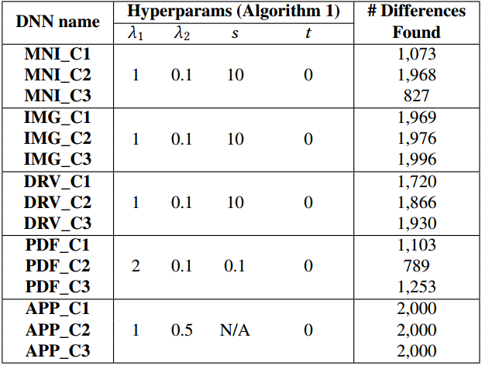
Evaluation
Can DeepXplore find numerous erroneous behaviors

Slide 48
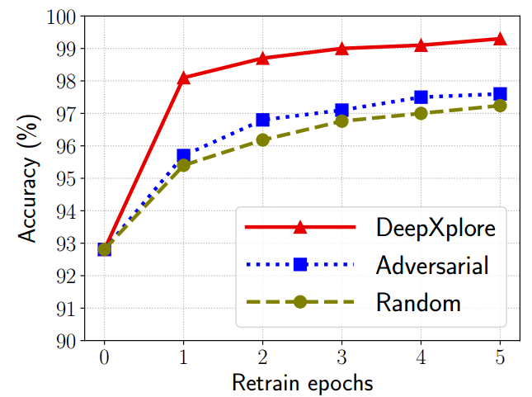
Evaluation
Can DeepXplore improve the accuracy of DNN
Improvement in accuracy by adding 100 new error-inducing samples

Slide 49

Thanks

